Slide 1


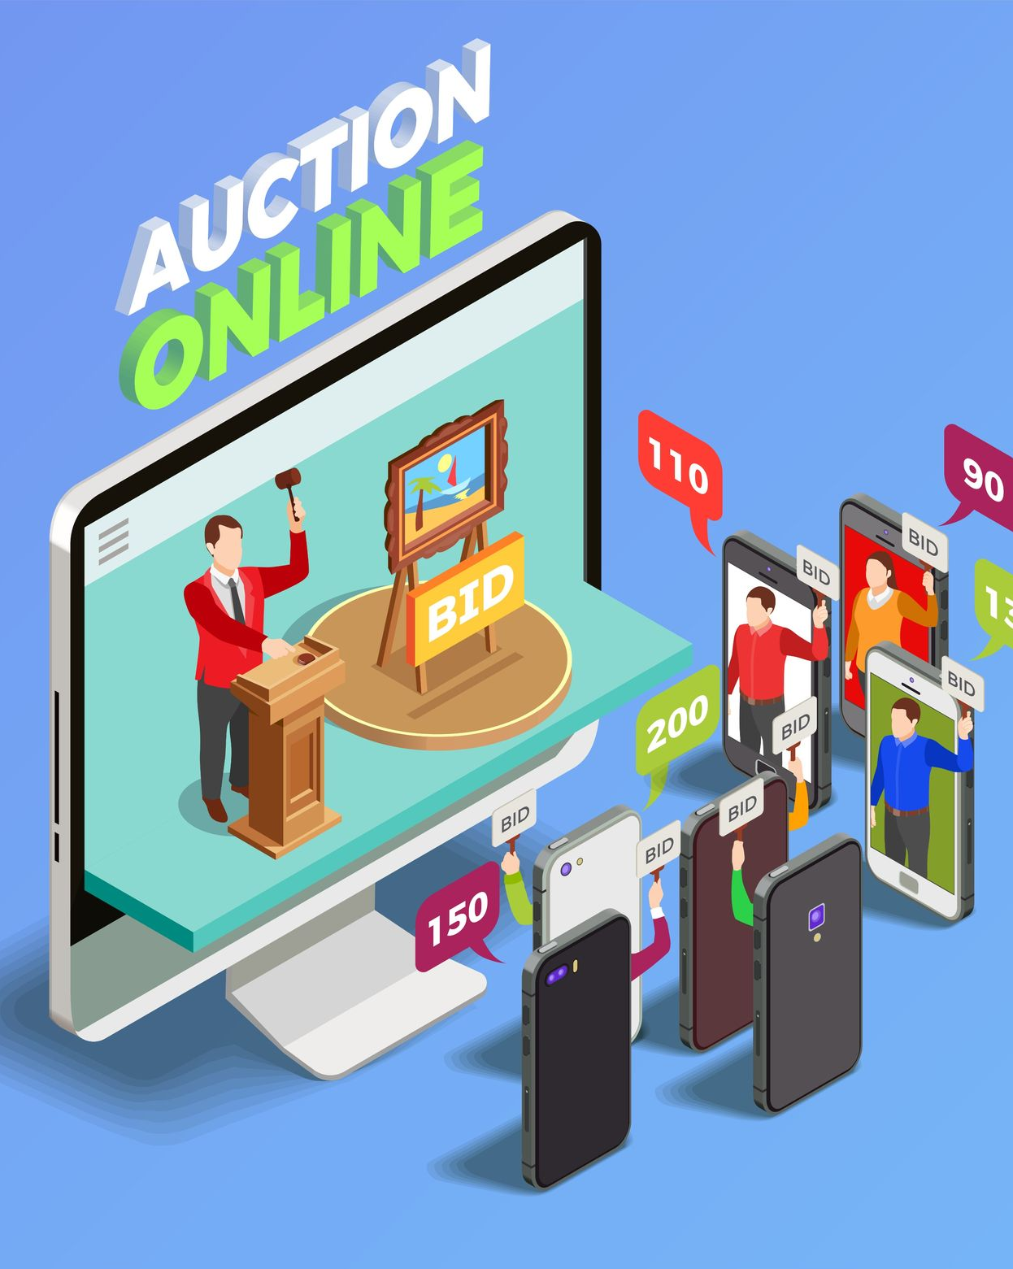

Online
Auction
Team
Unleashing Opportunities: Navigating the World of Online Auctions.

Slide 2
Introduction
List of team members
Nguyen Ngoc Ky Phong (Leader)
To Anh Tu
Nguyen Van Quoc
Nguyen Trung Nghia

Slide 3

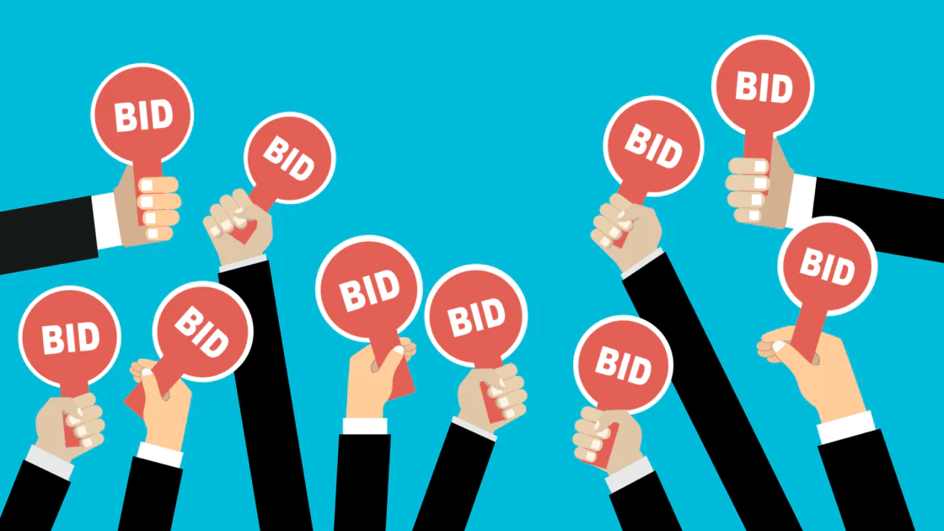
What is an online auction?
Introduction
Online auctions are auction activities through information systems. Organizations and individuals can independently organize online auctions or use the online auction services of other organizations or individuals. Auctions can take place through the auction floor or the seller's sales website.

Slide 4
Advantages of online auctions?
Introduction
No Time Constraints: Bidding can occur at any time. Products are listed for one or more days, allowing buyers to search, decide, and bid. The item’s value increases with more participants.
No Geographical Constraints: Vendors and bidders can join auctions from anywhere with Internet access, reducing attendance costs.
Social Interaction: Auctions provide a "game-like" experience, attracting participants beyond the goal of winning the item.

Slide 5
Project Goals
Introduction
Develop a simple yet effective online auction system.
Focus on basic features: item creation, bidding, and transaction management.
Prioritize user understanding of system functionality and interactions.
Provide a good experience for both buyers and sellers.
Create a fair and transparent environment for all participants.

Slide 6
Contents
P1. Survey, determination of requirements and ideas
P2. System analysis and design
P3. Demo

Slide 7
1. Survey
Survey, determination of requirements and ideas
Trends and overall market situation
Market survey
User needs
Survey scope

Slide 8

Online Auction Market Trends
1.1 Trends and overall market situation
Growth: The online auction market is booming due to Internet popularity and convenience. Consumers flock to online platforms for shopping and selling.
Diversification: Beyond electronics, auctions now cover real estate, art, sports gear, and services.
Competition: Fierce rivalry drives platforms to enhance user experience and deliver value.
Flexibility: From live to online auctions, diverse formats cater to both buyers and sellers.
Tech Innovation: AI, machine learning, and blockchain enhance safety and efficiency.

Slide 9

1.2 Markey survey
1. Lac Viet Auction: This is one of the largest auction houses in Vietnam. Lac Viet has always been a pioneer in applying information technology to auction activities. They successfully organized the first official online auction in Vietnam on July 17, 2020.

Slide 10
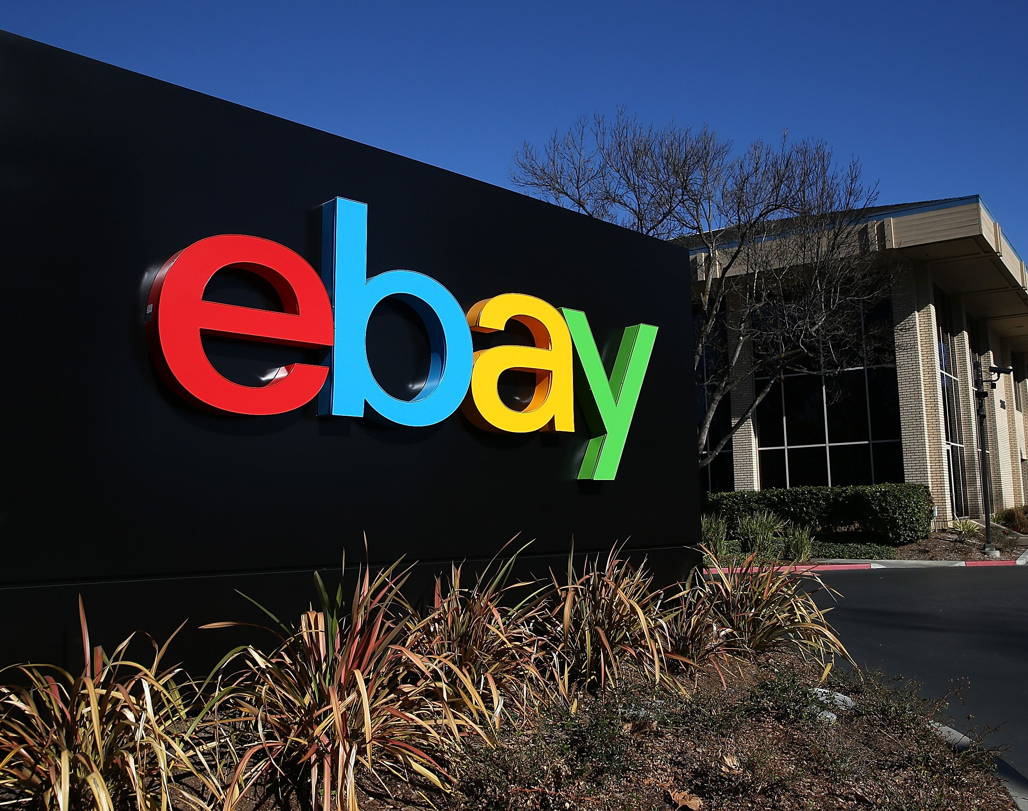
1.2 Markey survey
2. eBay: One of the most famous and popular online auction websites in the world. eBay allows users to auction buy and sell new and used goods.

Slide 11
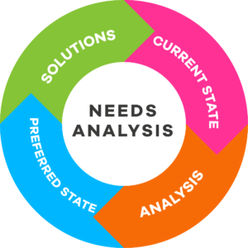
1.3 User needs
Product Diversity: Cater to diverse tastes—electronics, fashion, art, and more.
Value and Quality: Transparent descriptions ensure quality and value.
User Experience: Prioritize convenience, intuitive interfaces, and effective search.
Safety and Security: Protect personal information rigorously.
Flexibility: Accommodate varying auction durations.
Interaction and Feedback: Engage with buyers and address their opinions.

Slide 12
Online Auction Website Development Scope
1.4 Survey scope
Basic Features: Account registration, login, item listing, bidding, and transaction management.
User Interface: User-friendly design, emphasizing experience, aesthetics, and cross-device compatibility.
Safety and Security: Protect user data and ensure transaction integrity.
Database Management: Efficiently store product, user, and transaction information.
Performance Optimization: Techniques for scalability and responsiveness.
User Support: Documentation and help features.

Slide 13
2. Determine requirements
Survey, determination of requirements and ideas
General system requirements
Specific requirements for each function

Slide 14
Online Auction System Process:
2.1 General system requirements
Account Creation and Login:
Users register with essential details.
Access features after account creation.
Auction Item Listing:
Sellers create detailed listings.
Items are displayed for buyer viewing and bidding.
Bidding:
Buyers browse and bid on items.
The system updates the highest bid and notifies the end of the auction.
Rating:
Both parties rate.
Builds trust within the auction community.
User-Friendly Interface:
Smooth shopping experience for all users.

Slide 15
2.2 Specific requirements for each functions
1. User Registration and Login: Users must register and log in to access the Auction page.
2. User Types: The system has two user types: Managers and Normal users.
3. Home Page Dashboard:
Search Box: Allows users to search for individual items.
Categories List: Displays available categories along with the number of items sold in each category.
Sell an Item: Users can provide item details, upload images, set minimum bids, auction end dates, and bid increases.
4. Functional Search:
Case-insensitive search for items matching keywords.
Displays currently available items.
5. Browse Categories:
Clicking on a category opens a page showing all items for sale in that category.

Slide 16
2.2 Specific requirements for each functions
6. Buy an Item (Item Home Page):
Users can access the item home page by clicking on search results or navigating from category browsing.
The home section includes:
Title and Description: Information about the item.
Uploaded Image: If available, an image of the item.
Uploaded Documents: Relevant documents related to the item (if applicable).
Seller’s Name: A link to the seller’s review page.
Minimum Bid Price: If specified.
Current Bid Price: The current highest bid.
Bid History: A link to view previous bids and the users who placed them.
Bidding Increments: Information on bid increases.
Place a New Bid: Available for buyers (not sellers).

Slide 17
2.2 Specific requirements for each functions
7. Edit an Item (Sellers Only):
Sellers can edit items by:
Uploading a new image.
Uploading additional documents.
Changing bid increments.
8. Notifications:
When the auction end date approaches, both sellers and buyers receive notifications in the Notifications tab.
9. Review Mechanism:
A rating system for buyers and sellers:
Sellers rate buyers on a scale of -5 to +5 for each item sold.
Cumulative ratings reflect a buyer’s reliability.
10. Administrator Functions:
Admins can:
Block fraudulent users.
Add new categories and merge existing ones.

Slide 18
3. Idea
Survey, determination of requirements and ideas
System idea
User interface ideas
Ideas about technology and techniques used

Slide 19
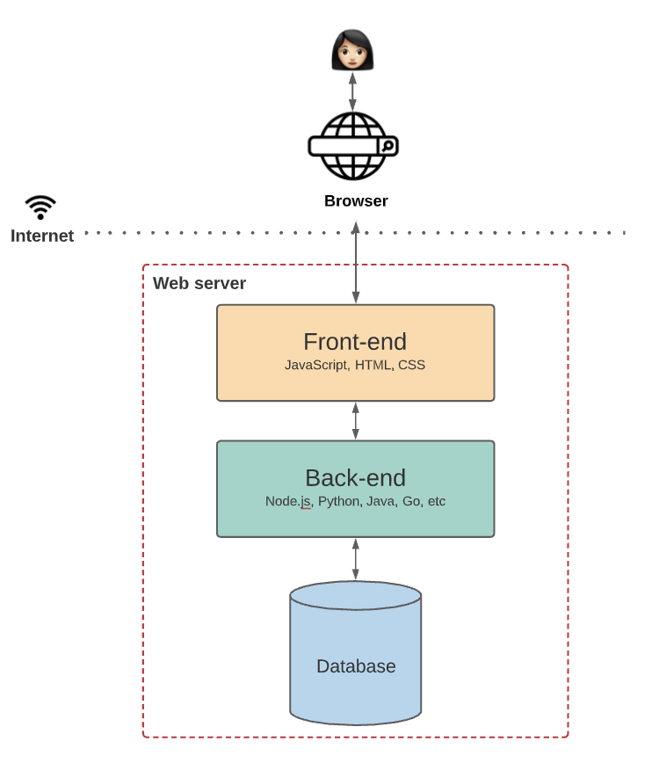
3.1 System idea
- In the project system, there are three main parts: backend, frontend and API
Frontend (Client Side)
Users directly interact with the frontend.
Responsible for data display and user interface.
Enables seamless user experience.
Backend (Server Side):
Handles user requests.
Interacts with databases.
Performs complex tasks.
API (Application Programming Interface):
Acts as a bridge between frontend and backend.
Frontend sends requests to the API.
API forwards requests to the backend for processing.
Backend responds to the frontend via the API.

Slide 20
Benefits of using the frontend-backend-API architecture for website development
3.1 System idea
Easier Application Maintenance
Improved Error Handling
Modularity and Scalability
Simplified Frontends
Streamlined Data Representation
Customization for Specific Frontends

Slide 21
3.2 User interface ideas
1. Main Page
Displays a list of auctioned or featured items.
Offers filtering and sorting options for easy product search.
Includes a clear search bar.
2. Product Details Page
Large, clear image of the product.
Detailed information: name, description, condition, starting price, and remaining auction time.
Direct bidding options from this page.
3. Registration and Login Page
Simplified forms for user registration and login.
Quick login via social media or Google accounts.
4. Create/Edit Item Page
Simple form for sellers to create new items.
Clear instructions for filling out product details.

Slide 22
3.2 User interface ideas
5. Transaction Page:
Displays the highest bid, remaining time, and winner (if applicable).
Allows users to manage transactions, including payments and shipping.
6. Notification Page:
Important transaction and account notifications.
Customizable notification settings.
7. Headers:
Logo and website name for brand identity.
Main navigation bar with essential links.
Search box for quick product searches.
Notification display.
Log out option.
8. Footer:
Quick links to the main page, log-in, registration, and support.
Site policies and terms information.

Slide 23

- Frontend
3.3 Ideas about technology and techniques used
Tool: Visual Code
Platform: NodeJs
Language: Javascript
Support libraries:
ReactJs
React Hooks
React-bootstrap
Formik
Yup
Prettier
Scss
Eslint
Design Pattern: Atomic

Slide 24

- Backend
3.3 Ideas about technology and techniques used
Tools: Visual Studio
Platform: .Net Core 7
Language: C#
Support libraries:
Entity Framework Core
Swagger
Design Pattern:
Repository
Dependency injection

Slide 25

- Database
3.3 Ideas about technology and techniques used
Platform: SQL Server 2022
Tool: MSSQL Server Management 19
Language: SQL

Slide 26
Contents
P1. Survey, determination of requirements and ideas
P2. System analysis and design
P3. Demo

Slide 27
1. System analysis
System analysis and design
Analyze topic requirements
Sitemap
Analyze system functions

Slide 28
2.1 Analyze topic requirements
System Overview:
An online auction platform for buying and selling goods.
Key features include user registration, login, and personal information management.
User Types:
Manager: Manages categories and users.
Buyer: Views auctioned items, places bids, and checks bid history.
Seller: Posts items for sale.
Home Page:
Displays featured items and search functionality.
Lists available categories.
Item Selling:
Sellers provide item details: title, description, image, minimum bid, auction end date, and bid increment.
Item Buying:
Buyers view auctioned items, place bids, and track bid history.
Rating System:
Buyers and sellers rate each other after transactions.
Notifications:
Automated notifications for auction end dates.
Automated Processes:
System manages notifications, item status, and bid updates.

Slide 29
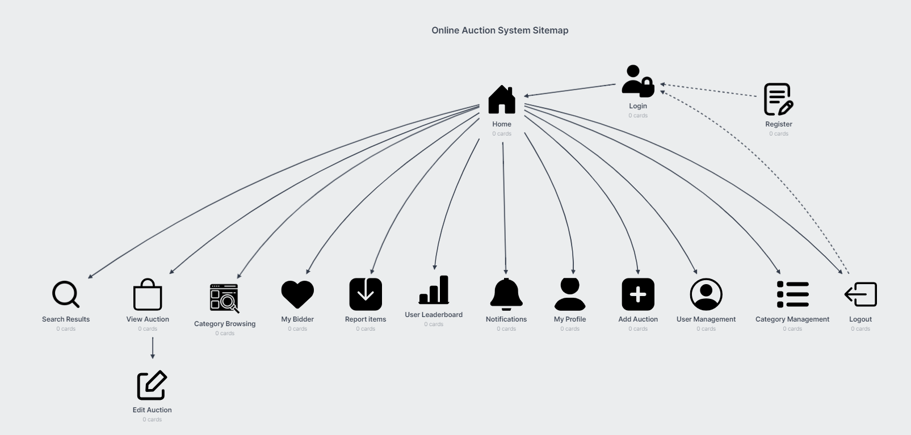
2.2 Sitemap

Slide 30
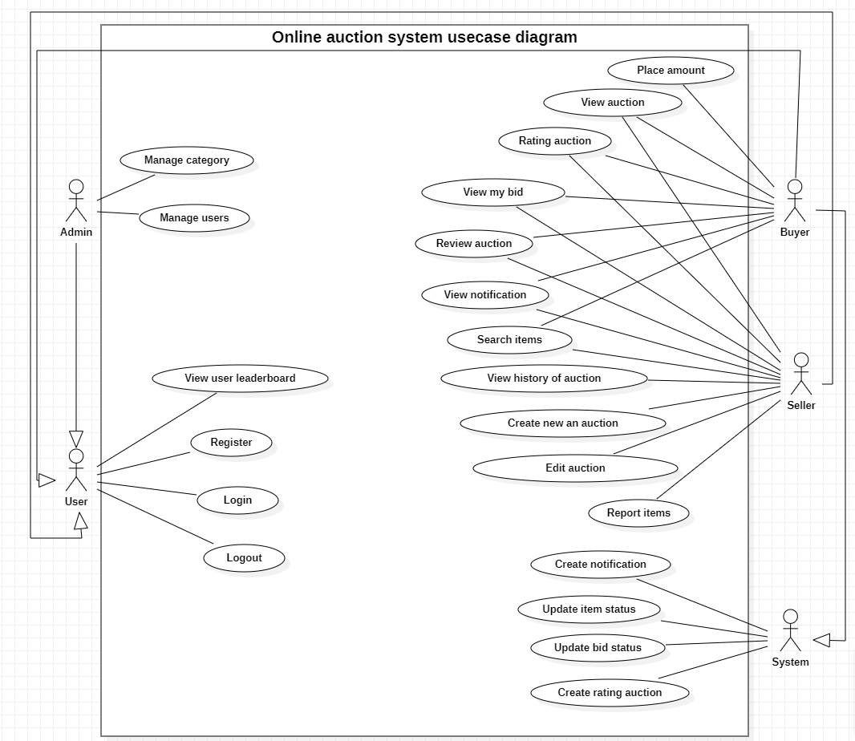
Usecase overview
2.3 Analyze system functions
- System actors include:
User (User): This is the basic user of the system. They can register, log in, log out, update their profile and view user rankings.
Manager (Admin): The manager has the right to manage categories and users in the system. They can add, edit, or delete categories and manage users.
Buyer: Buyers can bid, view auctions, rate auctions, view auction listings, view announcements, and search for items.
Seller: Sellers can view auctions, rate auctions, view auction listings, view announcements, search for items, and view auction history.
Automation System: The automated system will generate notifications, update item status and bids, and generate auction ratings.

Slide 31
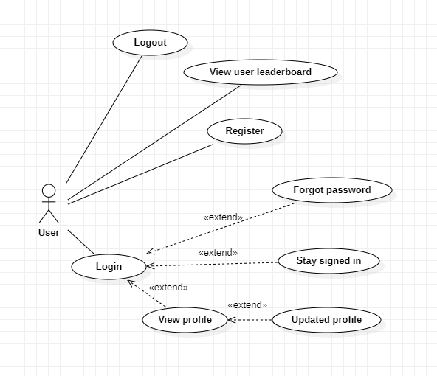
User overview usecase
2.3.1 Functions of the User object
User (User): This is the basic user of the system. They can register, log in, log out, update their profile and view user rankings.

Slide 32
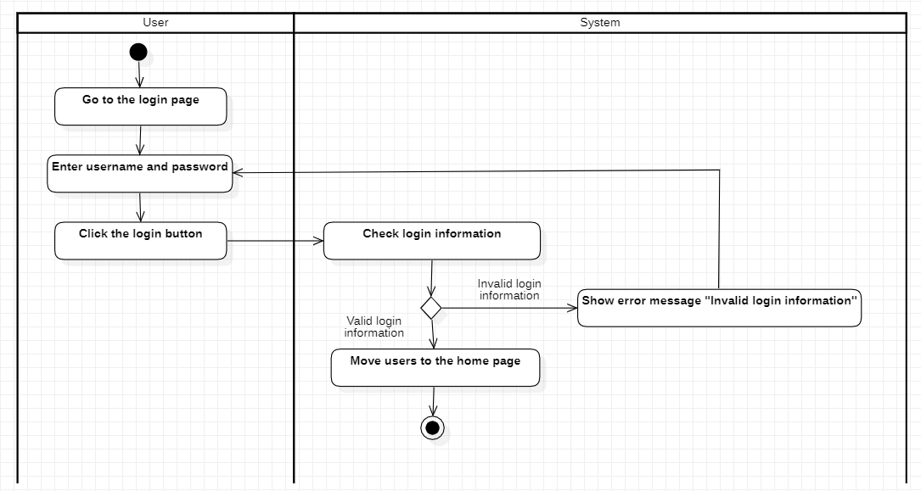
2.3.1.1 Usecase specification for user functionality
Use case name: Login
Actor: User
Use case description: Allow users to log in to the system
Request implementation: The user already has an account in the system
Preconditions: The user is not logged in
Postconditions: The user is redirected to the home page
Main event stream:
1. The user goes to the login page
2. The user enters username and password
3. The user presses the login button
4. The system checks login information
5. If the login information is valid, the system redirects the user to the home page
Secondary event stream:
A. Login failed
1. If the login information is invalid, the system will display the error message "Invalid login information"
2. Return to step 2 of the main event flow

Slide 33
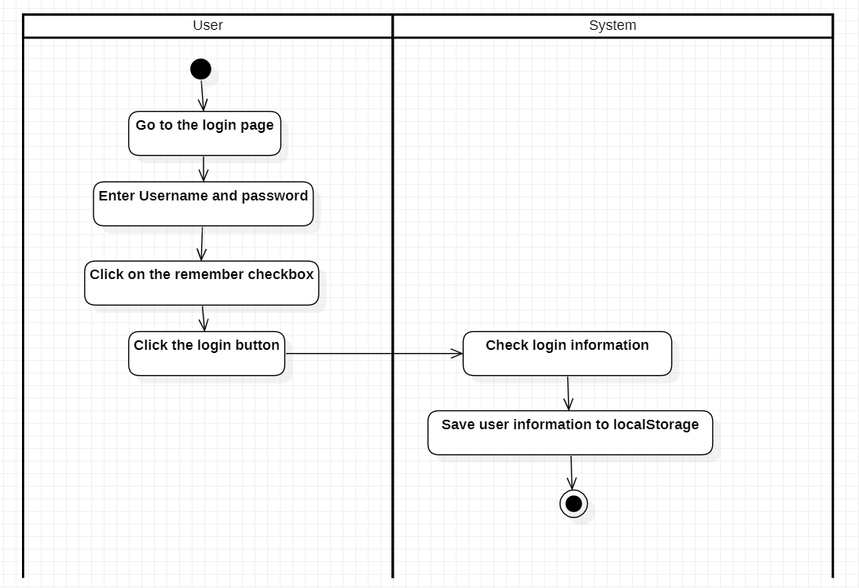
2.3.1.1 Usecase specification for user functionality
Use case name: Remember the user
Actor: User
Use case description: Allows users to register into the system
Request implementation: Do not have
Preconditions: Do not have
Postconditions: Users entering the system do not need to log in again
Main event stream:
1. The user goes to the login page
2. The user enters username and password
3. The user clicks on the Remember checkbox
4. The user presses the login button
5. The system checks login information
6. The system saves user information (including ID, username, full name, role, and token) into localStorage

Slide 34
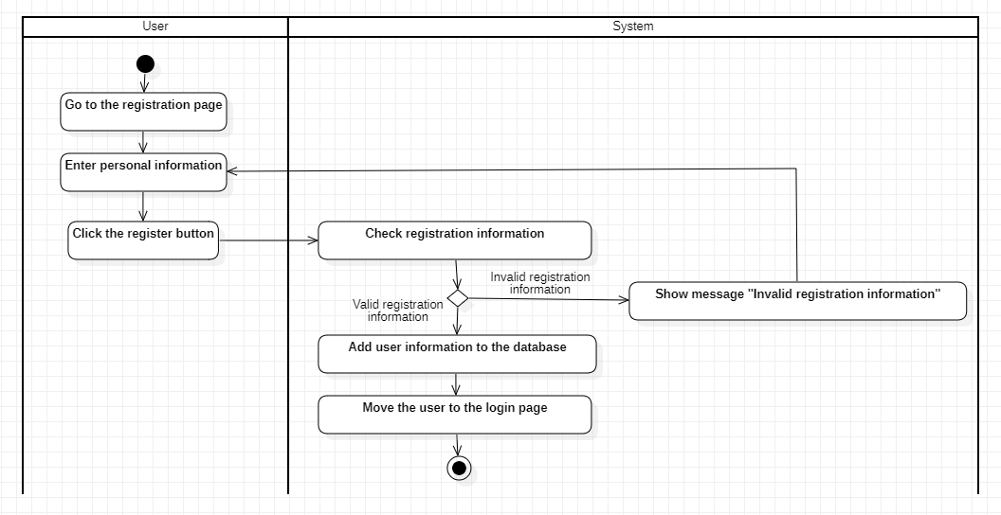
2.3.1.1 Usecase specification for user functionality
Use case name: Register
Actor: User
Use case description: Allows users to register into the system
Request implementation: Do not have
Preconditions: Do not have
Postconditions: User-created registration successfully
Main event stream:
1. User goes to the registration page
2. User enters personal information
3. The user presses the register button
4. The system checks registration information
5. If the registration information is valid, the system adds the user information to the database
6. The system redirects the user to the login page.
Secondary event stream:
A.registration failed
1. If the registration information is invalid, the system will display the error message "Invalid registration information"
2. Return to step 2 of the main event flow

Slide 35
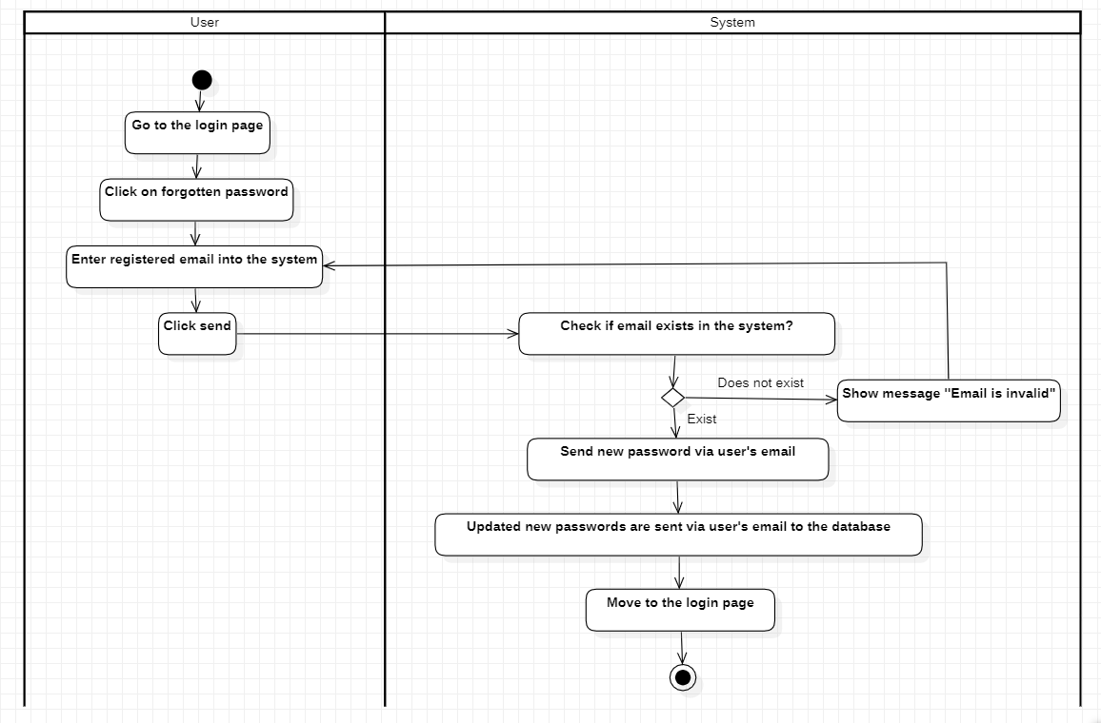
2.3.1.1 Usecase specification for user functionality
Use case name: Forgot password
Actor: User
Use case description: Re-issue a new password to the user via email
Request implementation: The user already has an account in the system
Preconditions: The user is not logged in
Postconditions: Users are re-issued a new password via email
Main event stream:
1. The user goes to the login page
2. The user clicks on the forgotten password
3. The user enters the email registered with the system
4. The user presses send
5. Does the email checking system already exist in the system?
6. If it exists, the system sends the new password via the user's email
7. The system saves new passwords sent via email into the database
8. The system redirects the user to the login page
Secondary event stream:
A. Sending email failed
1. If the email does not exist, the system will notify 'Email is invalid'

Slide 36
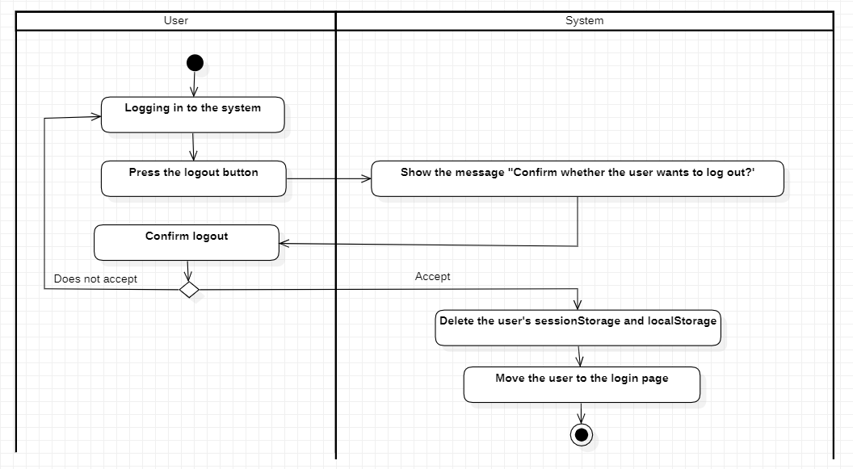
2.3.1.1 Usecase specification for user functionality
Use case name: Log out
Actor: User
Use case description: Allow users to log out of the system
Request implementation: Do not have
Preconditions: The user is logged into the system
Postconditions: The user successfully logs out and returns to the login page
Main event stream:
1. The user is logged in to the system
2. The user clicks the logout button
3. The system displays the message "Confirm whether the user is sure to log out"
4. The user accepts logout
5. The system deletes the user's sessionStorage or localStorage
6. The system redirects the user to the login page.
Secondary event stream:
A. Logout failed
1. If the user does not accept log out
2. Return to step 1 of the main flow of events

Slide 37
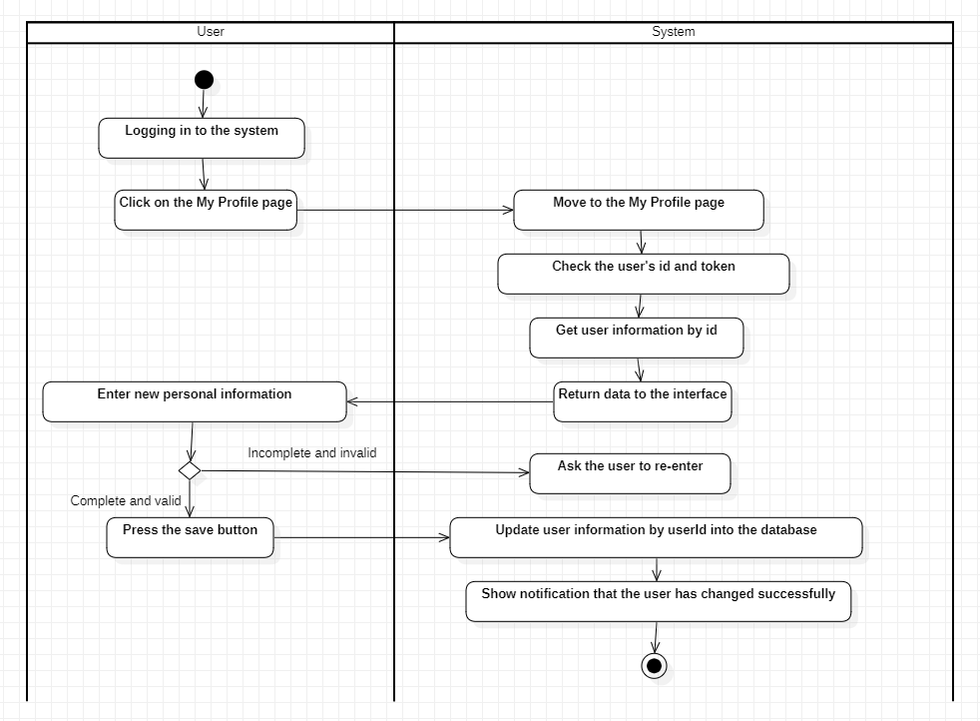
2.3.1.1 Usecase specification for user functionality
Use case name: Update user information
Actor: User
Use case description: Allows users to update personal information
Request implementation: The user must have role 0 or 1
Preconditions: The user is logged into the system
Postconditions: The user successfully updated personal information
Main event stream:
1. The user is logged in to the system
2. The user clicks on the My Profile button in the header
3. The system switches to the My Profile page
4. The system checks the user ID and token
5. The system retrieves user information by id
6. The system returns data to the interface
7. The user enters all new personal information.
8. The user presses the save button
9. The system saves user information by userId into the database
10. The system displays a notification that the user's information has been successfully changed.
11. The system returns to the previous page before entering the My Profile page

Slide 38
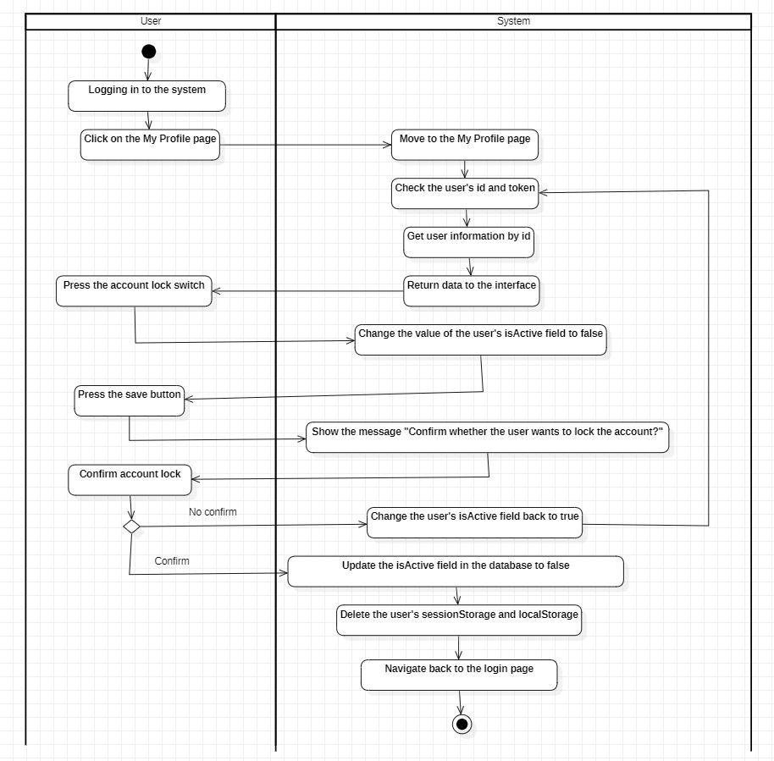
2.3.1.1 Usecase specification for user functionality
Use case name: Lock user information
Actor: User
Use case description: Allow users to lock personal accounts
Request implementation: The user must have role 0 or 1
Preconditions: The user is logged into the system
Postconditions: The user successfully locked their account
Main event stream:
1. The user is logged in to the system
2. The user clicks the My Profile button in the header
3. The system now switches to the My Profile page
4. The system checks the user ID and token
5. The system retrieves user information by id
6. The system returns data to the interface
7. The user presses the switch to lock the account.
8. The system changes the value of the user's isActive field to false
9. The user presses the save button
10. The system displays the message 'Confirm if the user is sure he wants to lock his account?'
11. The user confirms the account lock
12. The system updates the IsActive field in the user's database to false
13. The system deletes the user's sessionStorage and localStorage.
14. The system redirects the user to the login page.

Slide 39
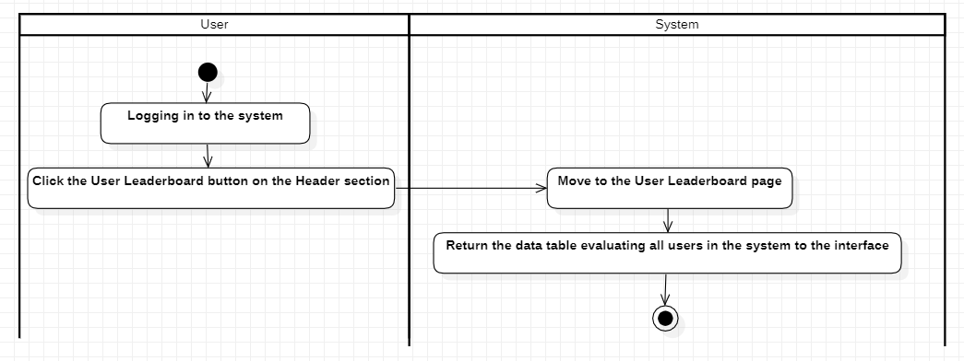
2.3.2.1 Usecase specification for user functionality
Use case name: View user rankings
Actor: User
Use case description: Allows users to view rankings
Request implementation: Do not have
Preconditions: The user is logged into the system
Postconditions: The user will successfully view the user rankings
Main event stream:
1. The user is logged in to the system
2. The user clicks the User Leaderboard button on the header
3. The system switches to the User Leaderboard page
4. The system returns the evaluation data table of all users in the system to the interface.

Slide 40
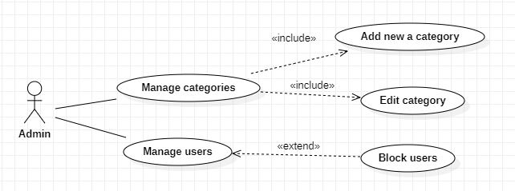
Manager overview usecase
2.3.2 Functions of Manager object
User (User): This is the basic user of the system. They can register, log in, log out, update their profile and view user rankings.

Slide 41
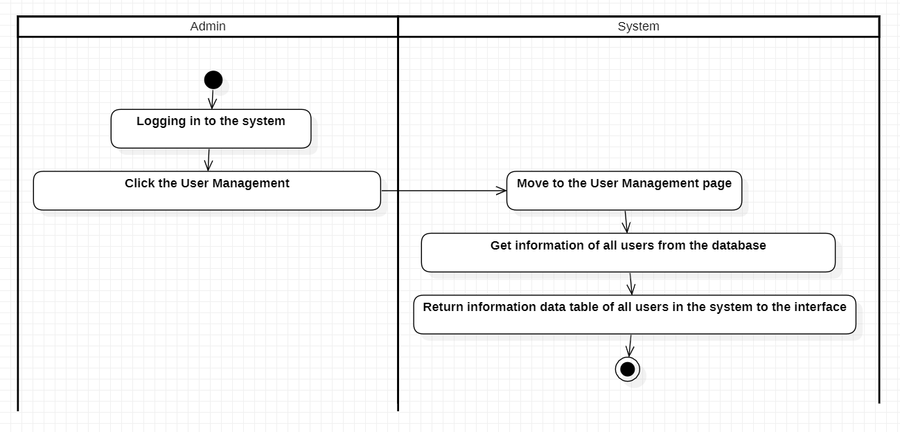
2.3.2.1 Usecase specification for manager functionality
Use case name: User management
Actor: Manager
Use case description: Allows managers to view information of all users in the system
Request implementation: The user must have role 2
Preconditions: The manager has logged into the system
Postconditions: The manager views the information of all users in the system successfully
Main event stream:
1. The manager is logged in to the system
2. The administrator clicks the User Management button in the header
3. The system switches to the User Management page
4. The system retrieves information of all users in the system in the database
5. The system returns a data table with information about all users in the system to the interface

Slide 42
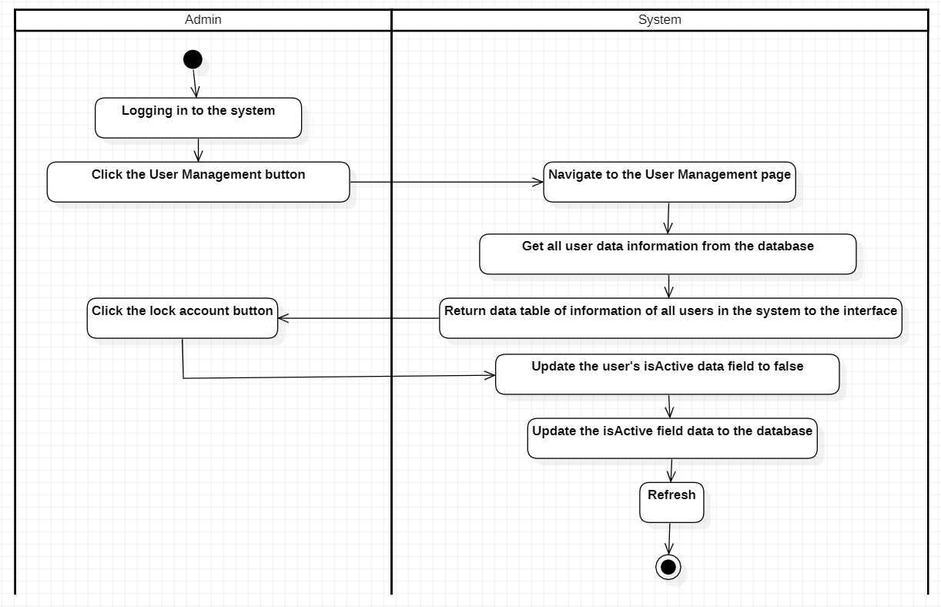
2.3.2.1 Usecase specification for manager functionality
Use case name: Block users
Actor: Manager
Use case description: Allows administrators to block users
Request implementation: The user must have role 2
Preconditions: The manager has logged into the system
Postconditions: The administrator successfully blocked the user
Main event stream:
1. The manager is logged in to the system
2. The administrator clicks the User Management button in the header
3. The system switches to the User Management page
4. The system retrieves information about all user data in the database
5. The system returns a data table with information about all users in the system to the interface
6. The manager presses the Lock account button
7. The system will update the user's isActive data field to false
8. The system saves changed data to the database
9. Refresh system

Slide 43
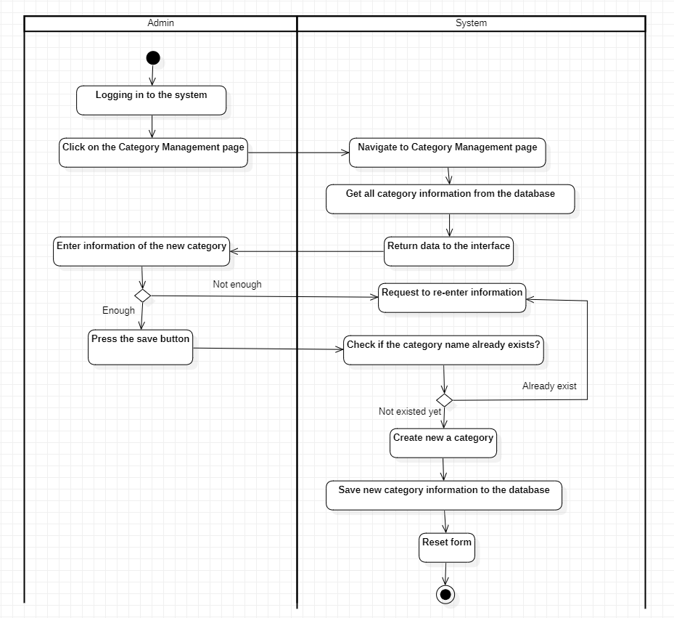
2.3.2.1 Usecase specification for manager functionality
Use case name: Add category
Actor: Manager
Use case description: Allows managers to add categories
Request implementation: The user must have role 2
Preconditions: The manager has logged into the system
Postconditions: The manager will successfully add a category
Main event stream:
1. The manager is logged in to the system
2. The manager clicks the Category Management button in the header
3. The system now switches to the Category Management page
4. The system retrieves information from all categories in the database
5. The system returns data to the interface
6. The manager enters complete information about the new category
7. The manager presses the save button
8. The system checks whether the category ID already exists
9. If not, the system creates a new category.
10. The system saves newly created category information to the database
11. The system resets the form

Slide 44
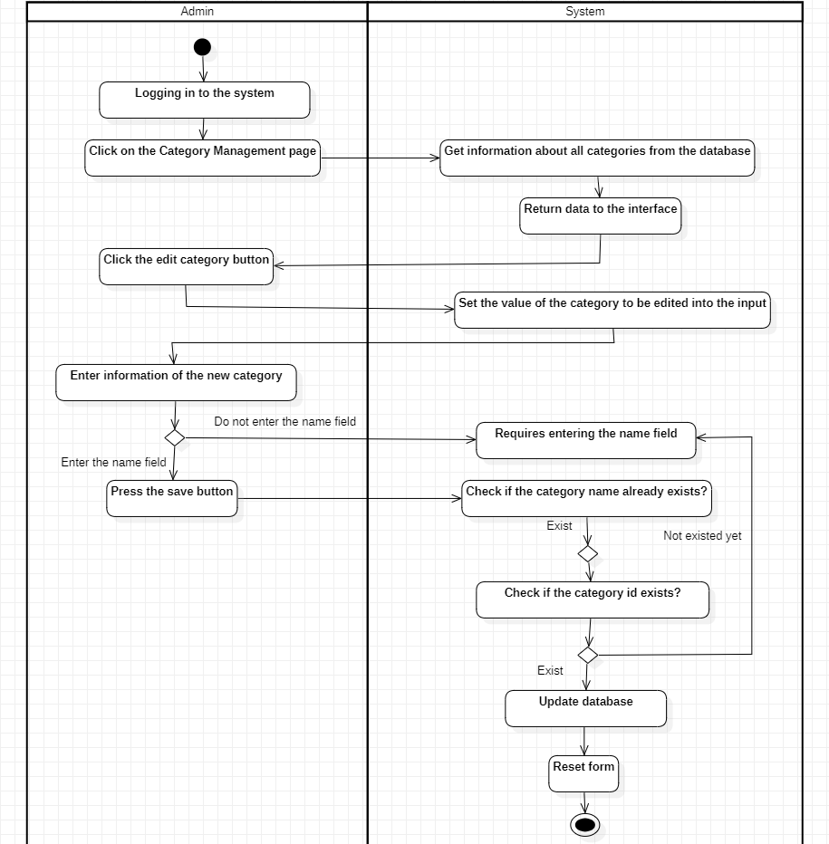
2.3.2.1 Usecase specification for manager functionality
Use case name: Edit Category
Actor: Manager
Use case description: Allows administrators to edit categories
Request implementation: The user must have role 2
Preconditions: The manager has logged into the system
Postconditions: The manager will successfully edit a category
Main event stream:
1. The manager is logged in to the system
2. The manager clicks the Category Management button in the header
3. The system now switches to the Category Management page
4. The system retrieves information from all categories in the database
5. The system returns data to the interface
6. The manager clicks the edit category button
7. The system will set the value of the category to be edited into the input
8. The manager fully enters the new information of the category
9. The manager presses the save button system checks whether the category ID already exists
10. If it exists, the system updates the category.
11. The system saves new category information to the database
12. The system resets the form

Slide 45
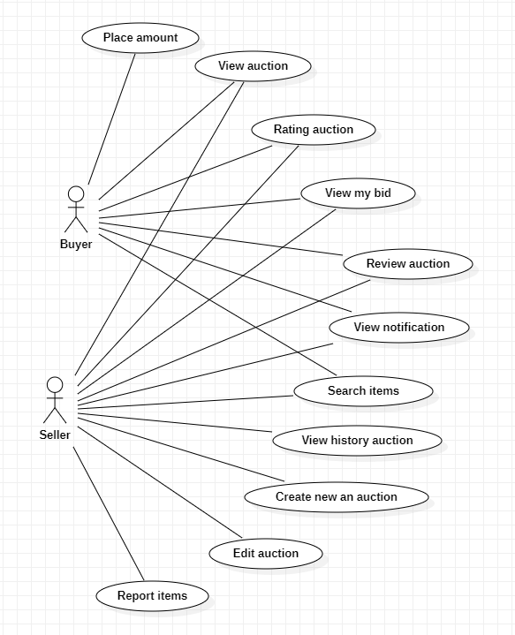
Buyer/Seller overview usecase
2.3.3 Functions of Buyer and Seller objects
Buyer: Buyers can bid, view auctions, rate auctions, view auction listings, view announcements, and search for items.
Seller: Sellers can view auctions, rate auctions, view auction listings, view announcements, search for items, and view auction history.

Slide 46
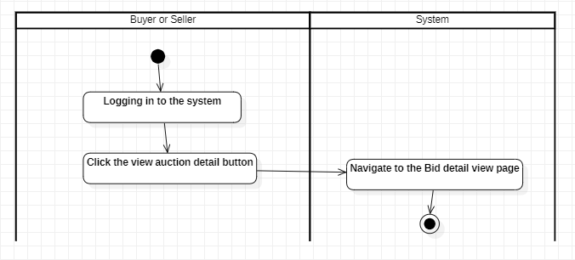
2.3.3.1 Usecase specification for buyer/seller functionality
Use case name: Watch the auction
Actor: Buyer/seller
Use case description: Allows Buyers/Sellers to view the auction
Request implementation: The user must have role 0 or 1
Preconditions: The buyer/seller has logged into the system
Postconditions: The buyer/seller will successfully view the auction
Main event stream:
1. Buyer and seller are logged into the system
2. Buyer and seller click the View Auction detail button
3. The system switches to the bid detail view page

Slide 47
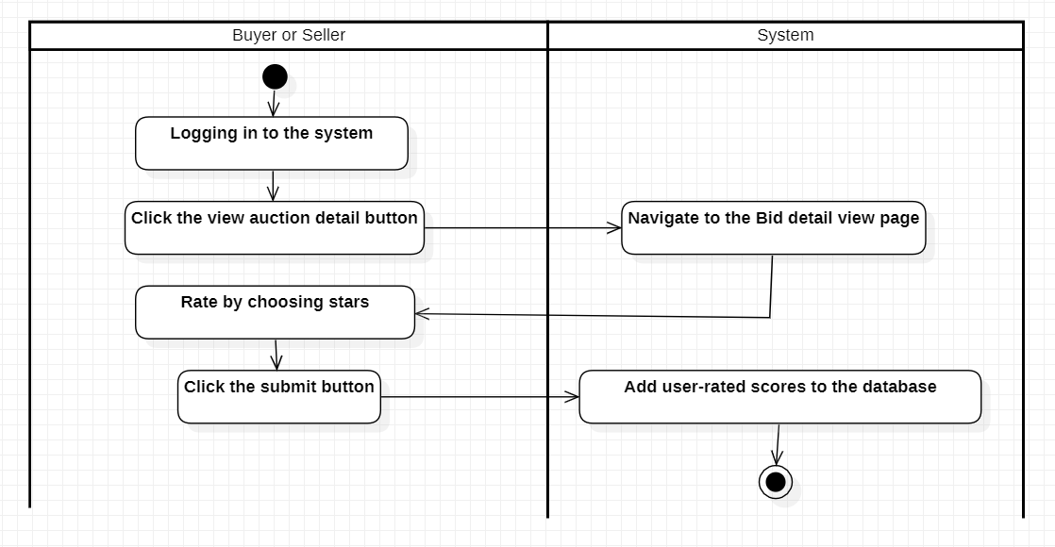
2.3.3.1 Usecase specification for buyer/seller functionality
Use case name: Buyer/seller reviews
Actor: Buyer/seller
Use case description: Allows Buyers/Sellers to rate each other
Request implementation:
+ User must have role 0 or 1
+ The auction must end
+ Only the auctioneer and the auction winner are allowed to rate
Preconditions: The buyer/seller has logged into the system
Postconditions: The buyer/seller will evaluate the success
Main event stream:
1. Buyer/seller is logging in to the system
2. Buyer/seller clicks on the view auction detail button
3. The system switches to the bid detail view page
4. Buyers/sellers rate by choosing the number of stars (from 0-5)
5. Buyer/seller clicks on submit form button
6. The system adds the evaluated score to the database

Slide 48
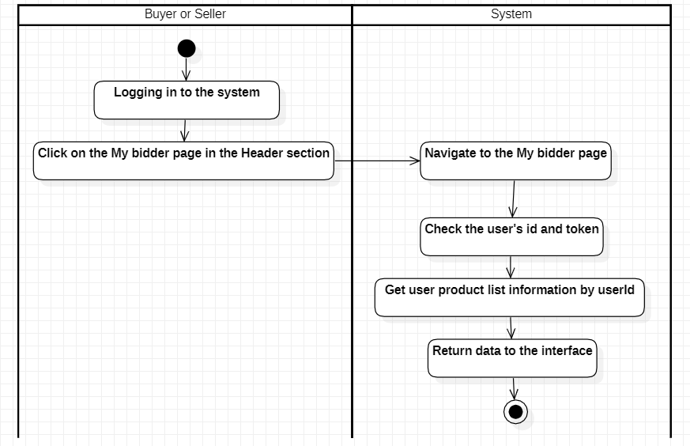
2.3.3.1 Usecase specification for buyer/seller functionality
Use case name: See the auction buyers/sellers participated in
Actor: Buyer/seller
Use case description: Allows Buyers/Sellers to see auction, which participated in
Request implementation: User must have role 0 or 1
Preconditions: The buyer/seller has logged into the system
Postconditions: Buyers/sellers will be able to see a list of auctions in which they participate
Main event stream:
1. Buyer/seller is logging in to the system
2. Buyer/seller clicks on the My Bidder button in the header
3. The system switches to the My Bidder page
4. The system checks the user's id and token
5. The system retrieves product information according to the user's ID
6. The system returns data to the interface

Slide 49
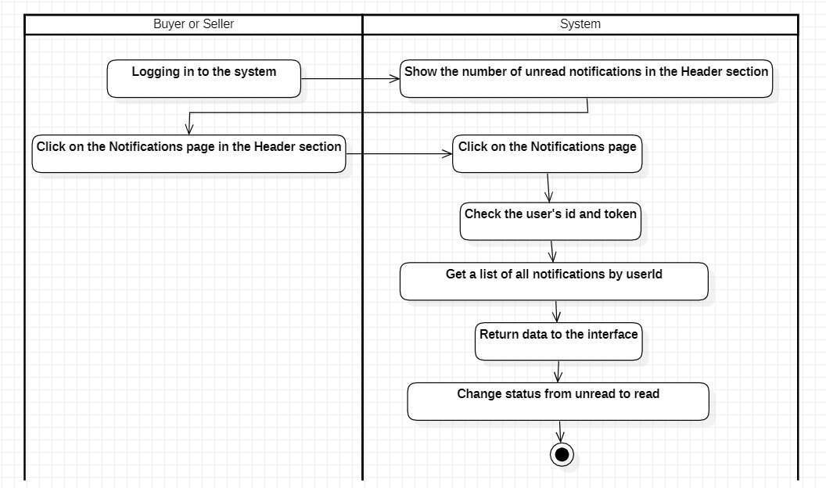
2.3.3.1 Usecase specification for buyer/seller functionality
Use case name: See announcement
Actor: Buyer/seller
Use case description: Allow Buyers/Sellers to view notifications
Request implementation: User must have role 0 or 1
Preconditions: The buyer/seller has logged into the system
Postconditions: The buyer/seller will see a list of success notifications
Main event stream:
1. Buyer and seller are logged into the system
2. Buyer and seller click the Notifications button in the header
3. The system switches to the Notification page
4. The system checks the user's id and token
5. The system retrieves information on all notifications according to the user's ID
6. The system returns data to the interface

Slide 50
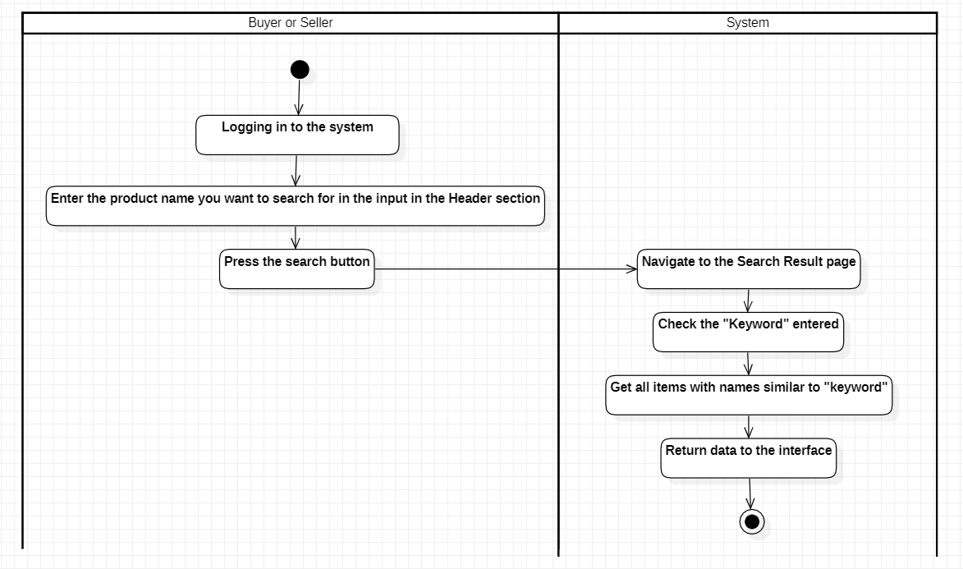
2.3.3.1 Usecase specification for buyer/seller functionality
Use case name: Search by product name
Actor: Buyer/seller
Use case description: Allow Buyers/Sellers to view notifications
Request implementation: User must have role 0 or 1
Preconditions: Buyer/seller has logged into the system
Postconditions: Buyer/seller will see a list of product names they searched for
Main event stream:
1. Buyer/seller is logged in to the system
2. Buyer/seller enters the product name they want to search for in the input in the header section
3. Buyer/seller presses the search button
4. The system moves to the Search Result page
5. The system checks the entered ''keyword''
6. The system retrieves all items with names similar to ''keyword'' (absolute search)
7. The system returns data to the interface

Slide 51
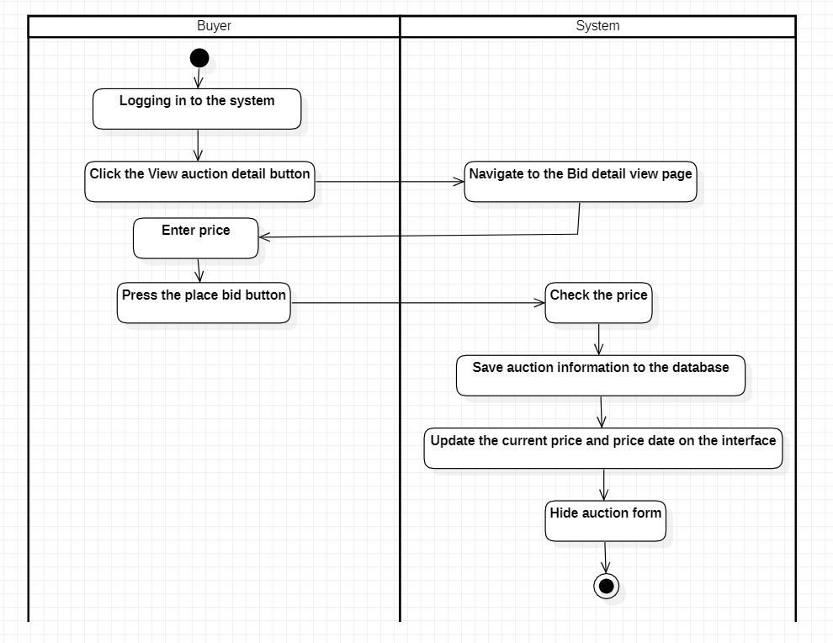
2.3.3.2 Usecase specification for buyer functionality
Use case name: Place bid
Actor: Buyer
Use case description: Allow buyers to set prices
Request implementation :
+ The user must have role 0
+ The auction is going on
+ Each buyer can only bid once
Preconditions: The buyer has logged into the system
Postconditions: The buyer will bid successfully
Main event stream:
1. The buyer is logged in to the system
2. The buyer clicks the View Auction detail button
3. The system switches to the bid detail view page
4. Buyer enters price
5. The buyer presses the place bid button
6. Price check system
7. The system saves auction information to the database
8. The system updates the current price and bid date on the interface
9. The system hides the bidding form

Slide 52
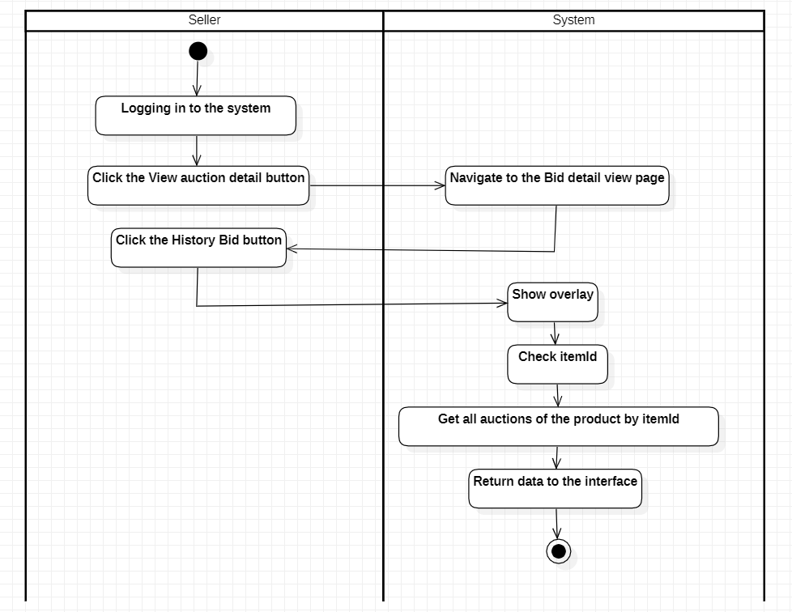
2.3.3.3 Usecase specification for seller functionality
Use case name: View auction history
Actor: Seller
Use case description: Allows sellers to view auction history
Request implementation:
+ The user must have role 1
+ There must be an auctioneer
Preconditions: The seller has logged into the system
Postconditions: The seller can see the list of users (with hidden information) bidding on their products
Main event stream:
1. The seller is logged in to the system
2. The seller clicks the View Auction detail button
3. The system switches to the bid detail view page
4. The seller clicks the History Bid button
5. The system shows the overlay
6. The system checks itemId
7. The system retrieves all auctions of the product by item
8. The system returns data to the interface

Slide 53
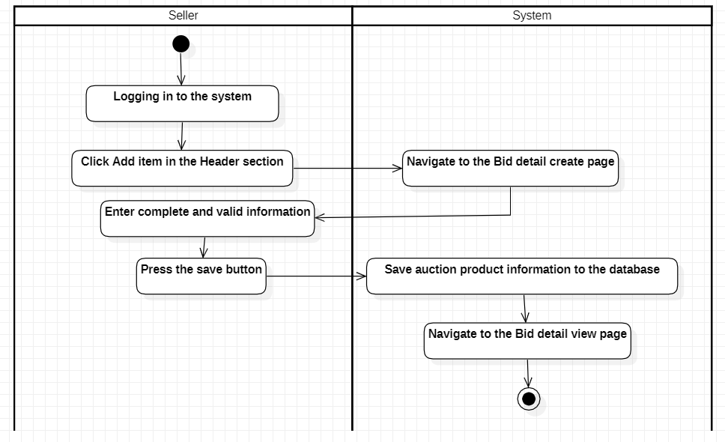
2.3.3.3 Usecase specification for seller functionality
Use case name: Create an auction
Actor: Seller
Use case description: Allow sellers to create auctions
Request implementation: The user must have role 1
Preconditions: The seller has logged into the system
Postconditions: The seller will successfully create the auction
Main event stream:
1. The seller is logged in to the system
2. The seller clicks the Add Item button in the header
3. The system switches to the bid detail create page
4. Seller enters complete information
5. The seller presses the save button
6. The system will save information on auction products into the database
7. The system will move to the bid detail view page

Slide 54
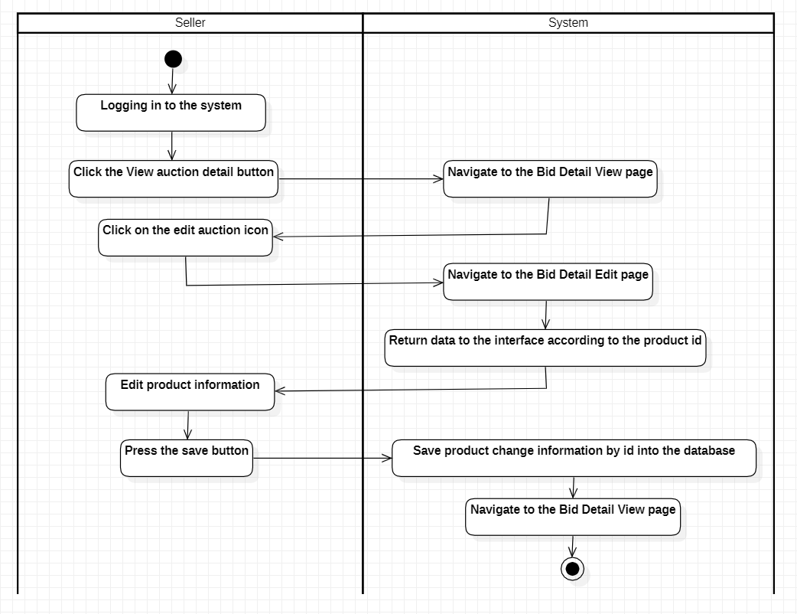
2.3.3.3 Usecase specification for seller functionality
Use case name: Edit auction
Actor: Seller
Use case description: Allow people to edit auctions
Request implementation:
+ The user must have role 1
+ The auction has not yet taken place
Preconditions: The seller has logged into the system
Postconditions: The seller will successfully create the auction
Main event stream:
1. The seller is logged in to the system
2. The seller clicks the View Auction detail button
3. The system switches to the bid detail view page
4. The seller clicks on the edit auction icon
5. The system switches to the bid detail edit page
6. The system returns data to the interface according to the product ID
7. Seller edits product information
8. The seller presses the save button
9. The system will save product change information by ID into the database
10. The system returns to the bid detail view page

Slide 55
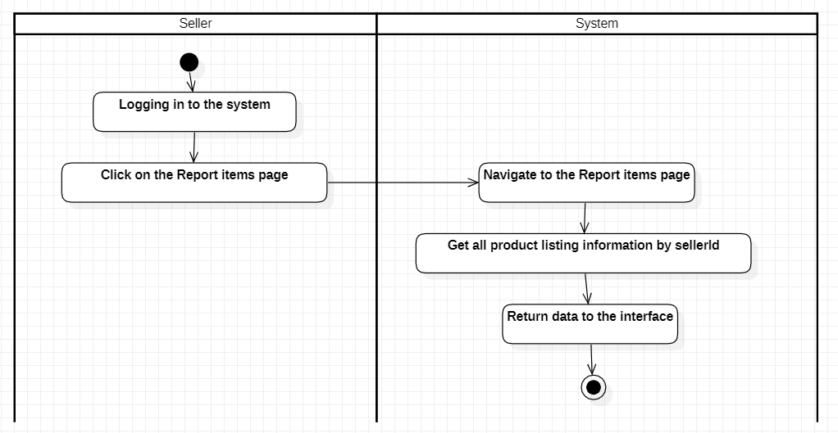
2.3.3.3 Usecase specification for seller functionality
Use case name: View product report
Actor: Seller
Use case description: Allows sellers to view statistics of their auctions
Request implementation: The user must have role 1
Preconditions: The seller has logged into the system
Postconditions: The seller will successfully view their auction listing
Main event stream:
1. The seller is logged in to the system
2. The seller clicks the Report items button in the header
3. The system switches to the Report Items page
4. The system retrieves all product list information from sellers
5. The system returns data to the interface

Slide 56
2. System design
System analysis and design
Interface design
Database design

Slide 57
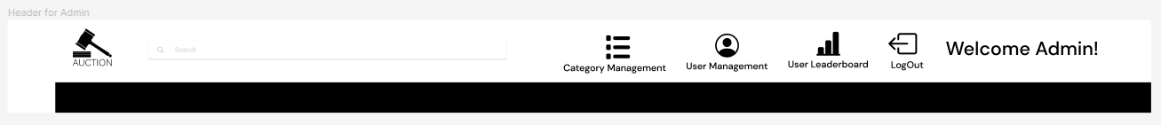
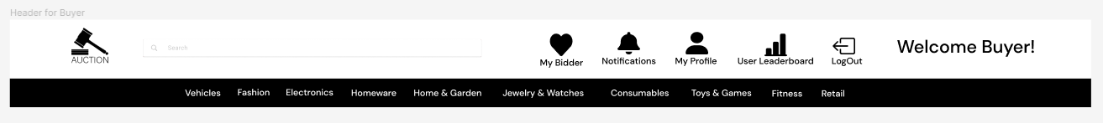
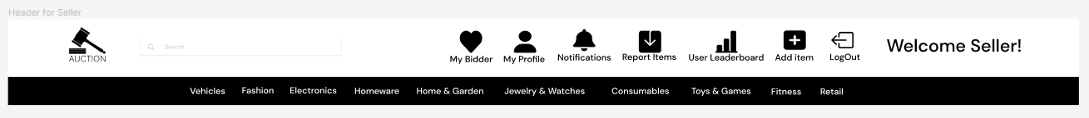
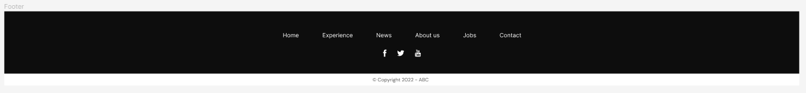
1. Interface design
Header interface for admin
Header interface for buyer
Header interface for seller
Footer interface

Slide 58
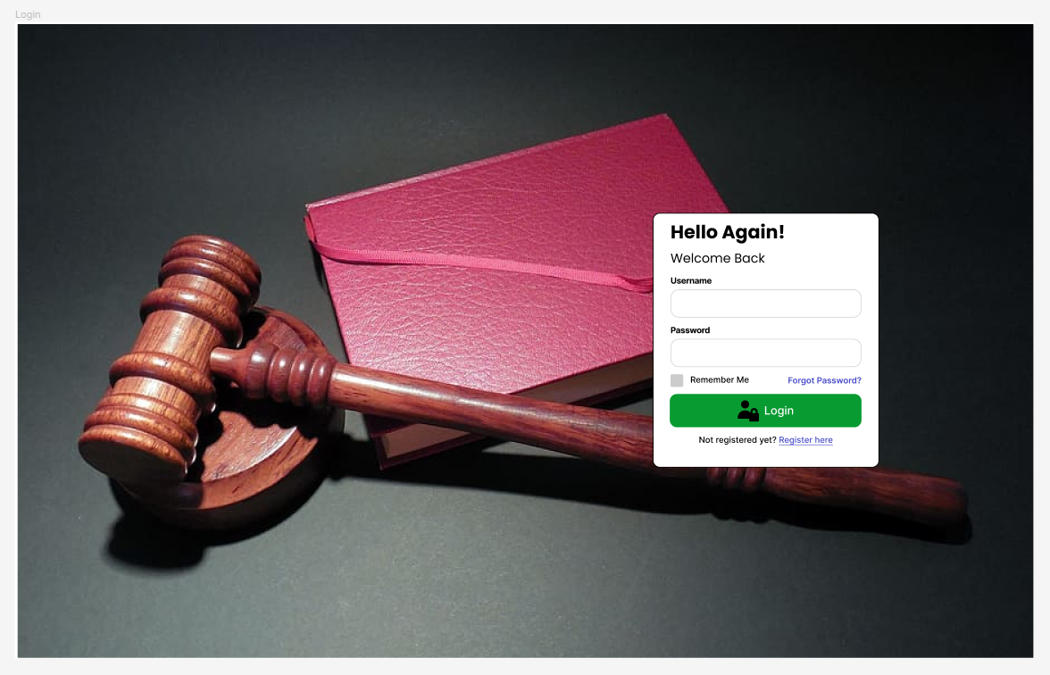
1. Interface design
Login page interface

Slide 59
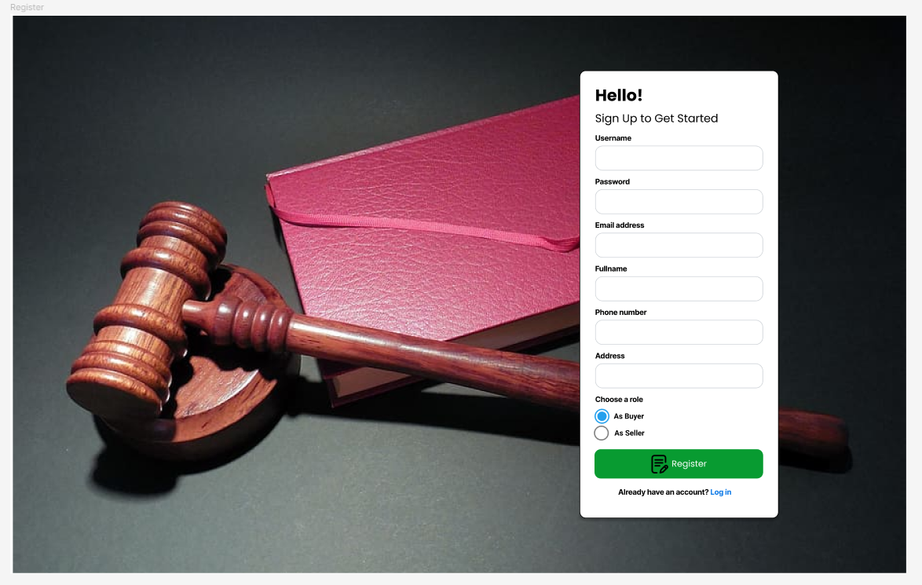
1. Interface design
Register page interface

Slide 60
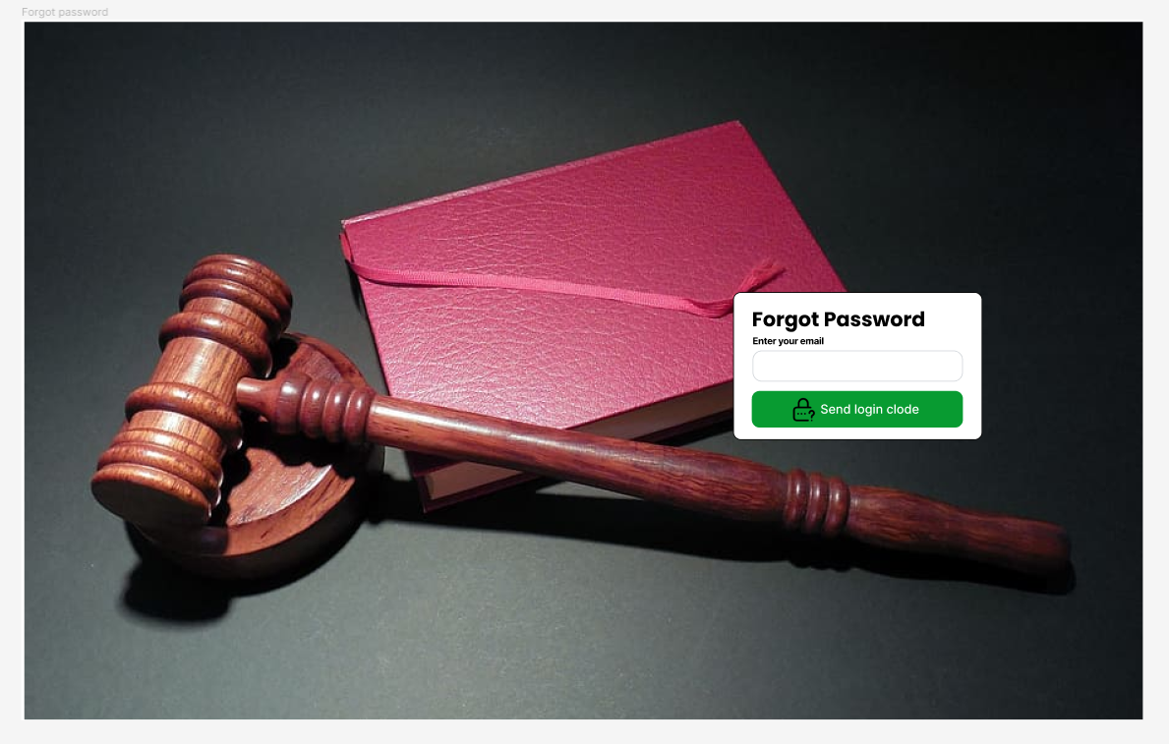
1. Interface design
Forgot password page interface

Slide 61
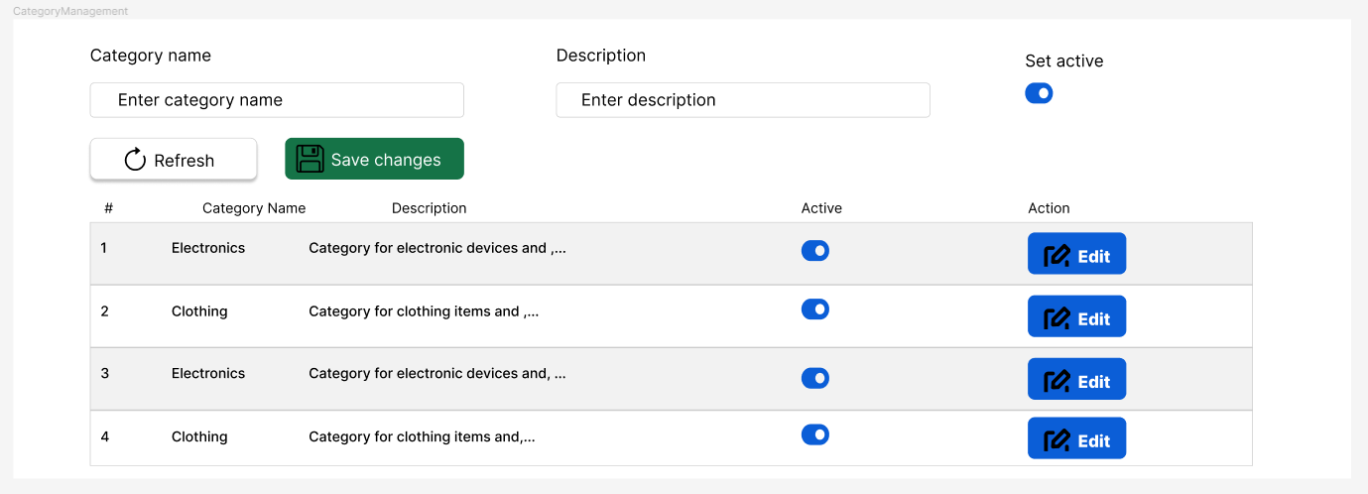
1. Interface design
Category management page interface

Slide 62
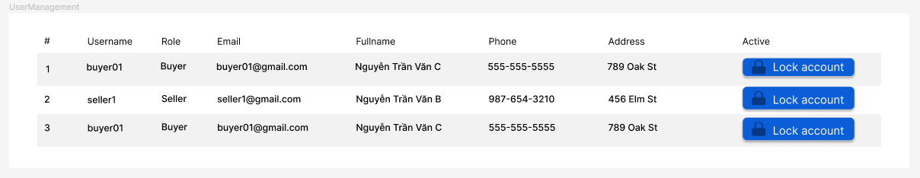
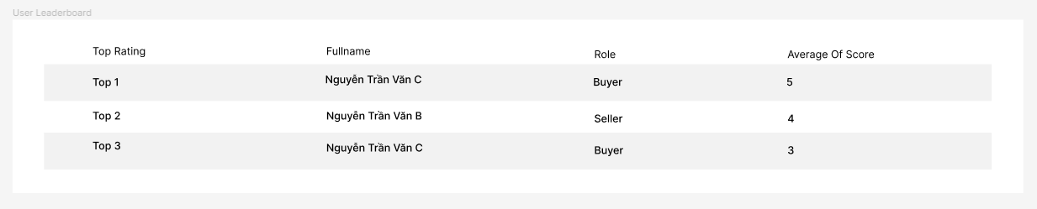
1. Interface design
User management page interface
User leaderboard page interface

Slide 63
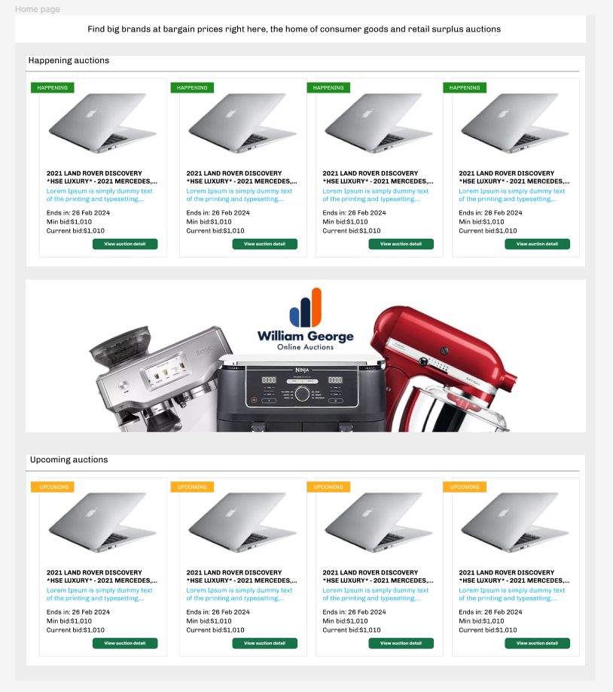
1. Interface design
Home page interface

Slide 64
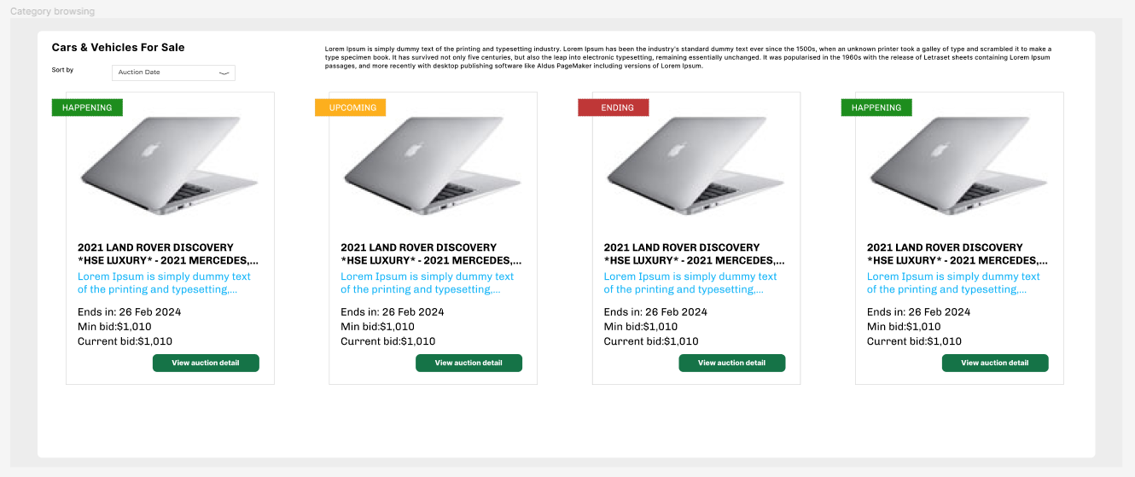
1. Interface design
Category browsing page interface

Slide 65
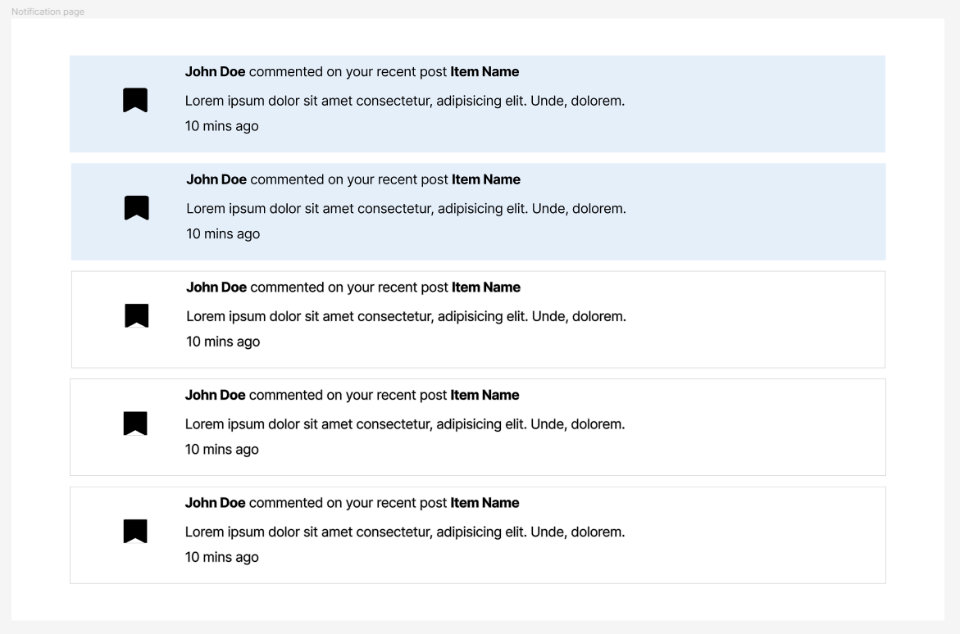
1. Interface design
Notification page interface

Slide 66
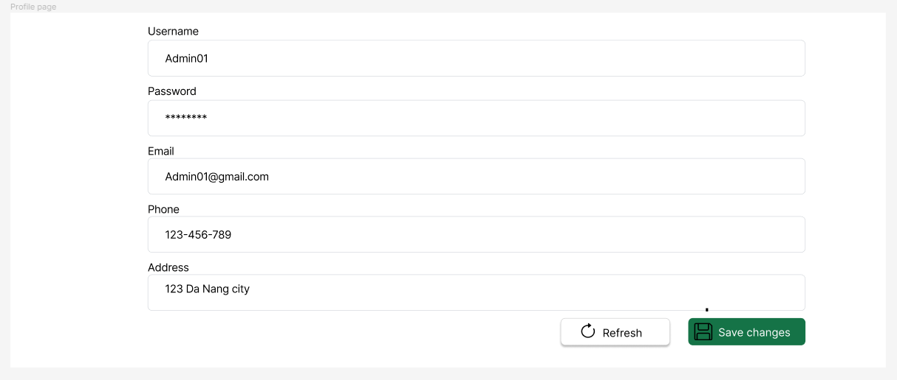
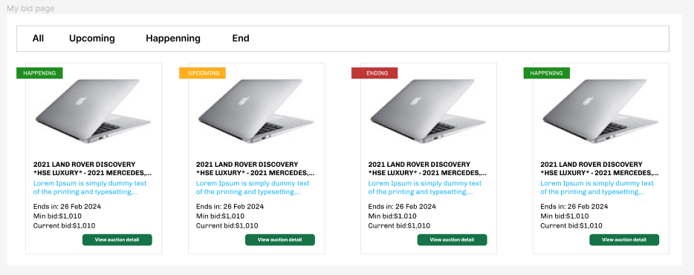
1. Interface design
Profile page interface
My bid page interface

Slide 67
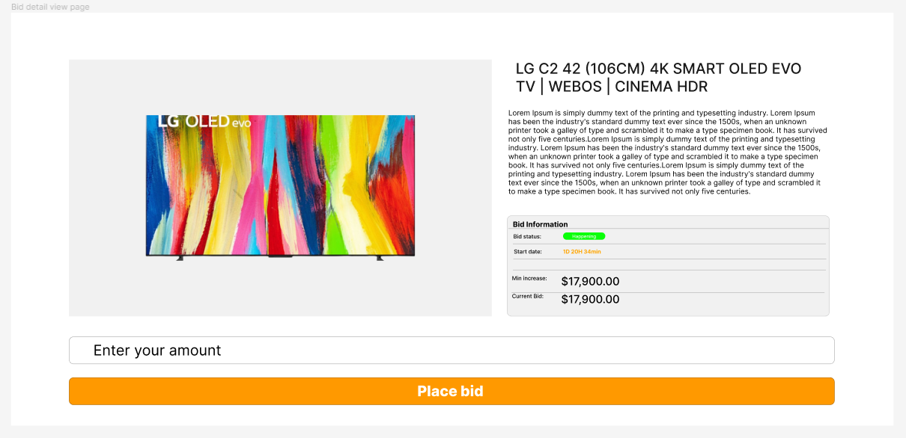
1. Interface design
Bid detail view page interface

Slide 68
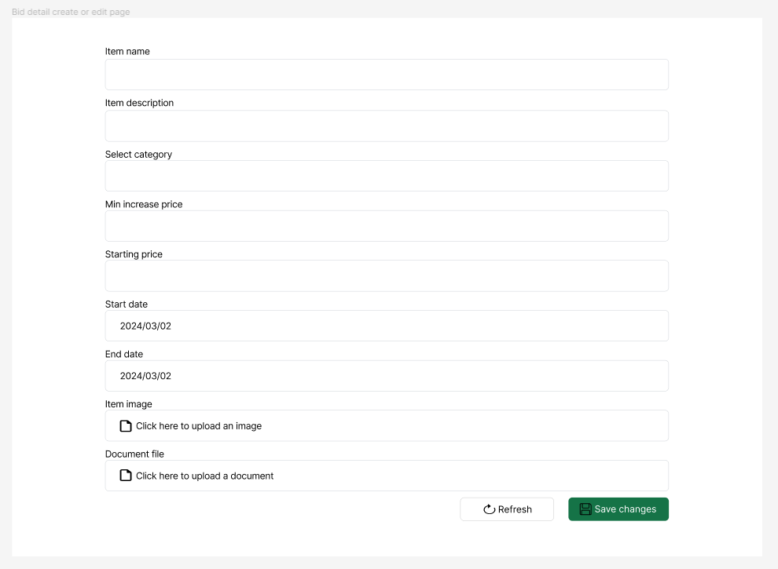
1. Interface design
Bid detail create or edit page interface

Slide 69
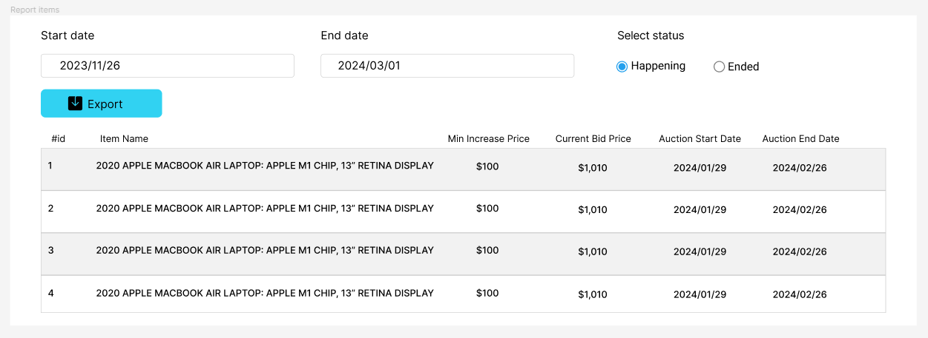
1. Interface design
Report item page interface

Slide 70

2. Database design
User table: Used to store user infomation
Bid table: Used to store information about bids
Item table: User to store information about items
Category table: Used to store information about item categories
Notification table: Used to store information about notifications
Rating table: Used to store assessment infomation

Slide 71
Contents
P1. Survey, determination of requirements and ideas
P2. System analysis and design
P3. Deployment
P4. Demo

Slide 72
Contents
P1. Survey, determination of requirements and ideas
P2. System analysis and design
P3. Demo

Slide 73


Slide 74
Conclusion
P1. Conclude
P2. Directions for project development

Slide 75
Conclude
Introduction
Although there have been many efforts to understand the knowledge learned, combined with searching specialized documents, due to limitations in time, ability and experience, certain shortcomings cannot be avoided and should be addressed.
Learn: Master ASP.NET Core, Entity Framework, and ReactJS for web programming and database management.
Apply: Build experimental applications for the online auction website.
Features: Implement basic functions (registration, login, auction) and advanced features (evaluation, notifications, automation).

Slide 76
Conclusion
P1. Conclude
P2. Directions for project development

Slide 77
Directions for project development
Introduction
Live Auction System: Enable real-time bidding for an interactive experience.
Robust Rating System: Expand reviews to cover product quality, delivery speed, and customer service.
Enhanced Notifications: Send notifications via email or text messages.
Advanced Search Options: Implement category-based, price range, and location-based searches.
Security Measures: Consider two-factor authentication, data encryption, and role-based access.

Slide 78
References
https://react.dev/
https://dotnet.microsoft.com/en-us/apps/aspnet/apis
https://www.microsoft.com/en-us/sql-server/sql-server-2022
https://learn.microsoft.com/en-us/dotnet/core/extensions/dependency-injection
https://learn.microsoft.com/en-us/dotnet/architecture/microservices/microservice-ddd-cqrs-patterns/infrastructure-persistence-layer-design
https://atomicdesign.bradfrost.com/
https://formik.org/
https://www.npmjs.com/package/yup
https://react-bootstrap.netlify.app/
https://learn.microsoft.com/en-us/azure/azure-functions/

